Slide 1
Content Strategy
for Yembo.ai
Created by Brittany Glasscock

Slide 2
Agenda
01
Current State and Goals Overview
How we will inform our content strategy
Content Strategy
Timeline
02
03
04

Slide 3
Current State and Goals
Yembo needs to optimize digital strategy and develop a repeatable marketing process to build awareness within the market, generate MQL/SQLs for sales team, and tell a story that nurtures leads through the sales funnel.
Yembo is in the startup phase of growth.
Yembo is aiming to add $4M in ARR in 2022.
Sales team has segmented obtainable market
Sales team has indicated 2022 focus of moving companies
Dev team is beta testing functionality that will expand Yembo’s market to include insurance providers
Yembo needs to drive brand awareness, and generate quality leads.
Yembo needs to create a marketing strategy that includes inbound and ABM marketing.

Slide 4
Marketing Goals
GOAL 1
Increase organic traffic by 10 percent QoQ
GOAL 2
Create a lead nurturing program that scores leads, walks them through the buyer’s journey, and hand off to sales
GOAL 3
Generate $2M in revenue via MQLs in 2022-23
Optimize social media accounts and create an active presence to drive social referral traffic
Create an engaged audience via Subscription campaign + premium content offers
Create a robust library including blog, social, and premium content
Create a robust SEO-driven content library, including premium offers, blogging, social media, etc
Create multiple conversion points on site pages and within content offers, including CTA sets, landing pages, and lead flow forms
Craft lead nurtures to support sales team by telling a story that helps customers understand Yembo & how AI revolutionizes their industry
Set up lead scoring & identify buyer personas
Create nurture programs for each persona
Build content offers relevant to each buyer persona
Unify Yembo’s Martech for Sales/Marketing data

Slide 5
How are we going inform our content strategy?

Slide 6
The Buyer’s Journey
BUYER STAGES
Awareness
Consideration
Decision
Behavior/ Actions | Aware that a problem/opportunity exists | Have defined the problem/opportunity | Know their plan of action to solve the problem/create opportunity
Research | Looking for information that confirms their expectations and is non-promotional. | Searching for the best plan of action to solving a problem or creating an opportunity. | Finding testimonials, benchmarks and data that help to support their decision.
Content Offers | Ebooks Guides Expert advice Educational blog content Industry research | Comparison sheets Webinars Video Chat/Podcast Expert guides Product Pages | Vendor comparisons Product brochures Case studies Free trial Demo Assessment/Calculator
Query Words | Troubleshoot, Upgrade, Issue, Improve, Resolve, Optimize, Risks, Enhance, Increase, Transform | Supplier, Vendor, Software, Technology, Tool, Service, Provider, Solution, Device | Pros & Cons, Versus, Benchmarks, Try, Review, Compare, Test, Assess, Comparison, Evaluate
Example Keywords | Improve moving inventory process Optimize client experience | Moving technology service Moving Inventory Software | Review of Yembo Software Pros & Cons of AI Inventory Software
What is the Buyer’s Journey?
The active research process we go through before making a purchase.
Awareness
Consideration
Decision
The Buyer’s Journey allows you to personalize your prospects’ experiences with Yembo by presenting relevant, valuable, and timely content when it is needed.

Slide 7
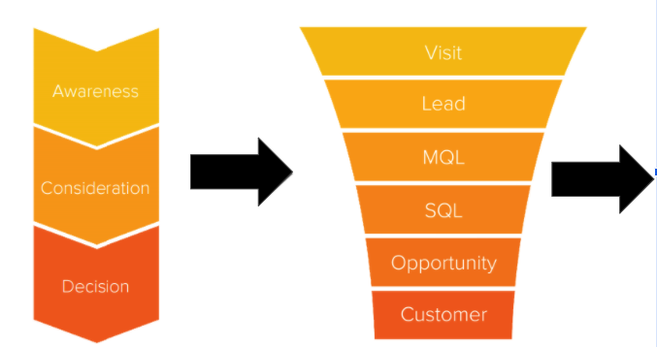
Lifecycle Stages & Sales Funnel
Lead Status Breakdown (proposed)
Awareness: Visitors & Leads
Landed on site
Blog subscriber
Visits 3-5 Solutions pages
Consideration: MQL & SQL
Has downloaded premium content offer
Trade show contacts
Has requested a demo
Is enrolled in MQL to SQL nurture
Has downloaded/viewed case studies
Decision: Opportunity & Customer
Has spoken with sales
Has downloaded a decision-stage content offer
Has completed a demo
Yembo sales team has identified as qualified
Notes:
Once we have a steady stream of users in the sales flow we can create lead scoring automation in Hubspot that will notify sales once a contact has reached a ‘score’ denoting an SQL

Slide 8
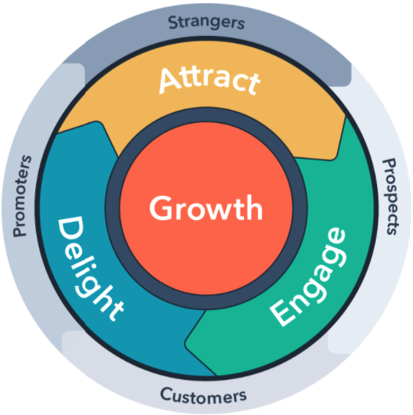
Inbound Marketing Flywheel for Content Strategy
The marketing funnel assumes that once we have closed a sale, the buyer’s journey is complete. “Funnel vision” doesn’t move companies forward.
Therefore we create content using inbound methodology phases:
Attract visitors with useful content & make it easier to reach our audience.
Engage prospects by building a trusting relationship, creating the content we know they’re searching for on our site. Taking an omnichannel approach to tailor messaging to their company, posing the customer as the hero
Delight Yembo’s customers by helping, supporting, and empowering them to reach their goals.
Source

Slide 9
Attract

Slide 10
SEO
Organic search offers a tremendous opportunity to effectively generate new web traffic. You can capitalize on organic search through site optimization, link building, and a solid keyword strategy.
Conduct an organic keyword analysis to identify target keyword & topic clusters
Audit current on-page content to optimize H1-H6 tags
Audit current on-page content & add FAQ Schema Markup to relevant H2’s and content
Use a topic cluster site structure to build search authority. Create pillar pages for core topics and link to supporting blog content.
Create a resources/learning center to house content and let contacts own their own AI Survey Tool journey.
Build a robust backlinking strategy to increase DA & build relationships with reputable sources
Notes:
Try Hubspot’s Website Grader Tool

Slide 11
Blogging
Blogging is an important strategy for any business concerned with organic visibility. In fact, companies that blog 2-3 times per week receive significantly more traffic, leads, and customers than those that blog less frequently.
Post a minimum of 4 blogs per month at a regular cadence.
Create blogs that align with target keywords and search intent
Create topic clusters to ensure blogs are easily navigable by topic
Ensure each blog has at least 3 internal links and externally link to reputable sources.
Leverage partnerships within the AI industry, moving services industry, insurance industry partners for guest blogging opportunities
Add two conversion points within each blog: inline CTA and banner CTA at the end of posts.
Create a blog subscription form and a branded email template for the delivery of new posts to subscribers inboxes.

Slide 12
Yembo’s Buyers Journey: Blog Content
Awareness
Consideration
Decision
What is Digital Inventory Management?
On-Site vs Virtual Surveys: Which is Better?
How AI Surveying Can Revolutionize the Moving Services Industry
The Top X Features Your Virtual Survey Software Should Offer
How AI Survey Software Creates a Real-Time Digital Inventory for Relocation and Moving Services
Customer Spotlight (Leadership that match our ICP)
How Yembo’s Virtual Home Surveys Drive Moving & Relocation Productivity

Slide 13
Yembo’s Buyers Journey: Premium Content
Premium content is aligned to a buyer’s behavior. We ask: what are the actions a buyer will take and what are the resources they will need to help them solve their problem and/or optimize their existing process? Premium content is of higher value and you should be giving just as much information as you’re asking for.
Awareness
Consideration
Decision
Video vs Virtual Surveys Infographic
X Reasons Why Virtual Surveys Should Be at the Core of Your Digital Transformation Strategy Ebook
Virtual Survey Walkthrough: How Does Virtual Survey AI Work?
At home
At work
For insurance companies
Should I Switch to Digital Surveying? Checklist
Digital Inventory Template
How to Integrate AI Software into Your Moving Services
Quick Start Guide
Digital Strategy for Beginners
Incorporating Yembo’s Software
Request a Demo Interactive Survey Tool
User Guides & Manuals
Pricing Guide

Slide 14
Social Media
Social media offers a powerful medium through which to learn about your prospects, find new prospects, engage with industry influencers, and expand the reach of your content distribution.
Follow the 60/30/10 rule: 60 percent industry articles, 30 percent blog articles, 10 percent inbound content (pages/content offers)
Optimize Facebook company page: This acts as a microsite for Yembo, a more casual place for people to get to know you before they land on the site. They also have the opportunity for 1:1 connection via messenger & reviews
Optimize Twitter and get more active - a lot of your digital leaders are going to want the real-time messaging and quick interactions
Encourage employees to join professional networks on LinkedIn and remain active & optimize your LinkedIn profile (it’s your digital billboard)
Share Yembo content on social media to help grow the channels and increase traffic to the website
Conduct a social media profile audit and optimize profiles to create a well-rounded digital presence before contacts land on Yembo’s site
Encourage Yembo employees to share and interact with content to generate more web traffic
Include interactive social media posts, including polls & AMA

Slide 15
Engage

Slide 16
Conversion Rate Optimization & Strategy
Yembo currently has 3 pieces of gated content: Awareness-level ebook, and consideration/decision whitepaper & ROI calculator
Recommend creating CTAs to place in key areas of the site: blog, solutions pages
Create lead flow pop up to generate conversions on key pages
Once Yembo has a larger content library, awareness level premium content should be ungated and live on education-rich pillar pages
Ramp up content creation efforts to build a library of content to increase conversion opportunities for users across the site
Move all forms into Hubspot for improved conversion rate transparency & reporting
Create a variety of CTA conversions on capabilities pages: an RSS blog feed or ‘Related Content’ sections
Create a CTA strategy that adds CTAs in context and in line with the buyer’s journey
Example: On the Moving Services page, keep the 2-Minute Test in the Hero but maybe keep conversions in line with the section.
Remove the second ‘Try it Now’ and ‘Request a Demo’ & teach them about what AI survey is/does,
Show Related Content/Blog RSS feed.
Next section, how Yembo helps
Add related conversion-level content, then
Lastly have a walkthrough video
Offer a Demo & 2nd Iteration of 2-Minute Test

Slide 17
Email Marketing
Email marketing should be a cornerstone of your content marketing strategy, with each campaign employing best practices in frequency, design, copy, and offer presentation.
As we develop premium content and pillar pages, creating promo emails will engage Yembo’s current database and provide value to current customers
Lists can be segmented in Hubspot to align with buyer personas & stage in the buyer’s journey
Use Salesforce functionality for more effective sales outreach.
Create a monthly newsletter to send with Yembo’s top resources
Make sure that each email contains a CTA to provide a clear path for leads to continue engaging with Yembo’s content
Provide a variety of content in emails so readers are being told an entire story from start to close
Prioritize:
Blog subscription emails
Premium content email promotions
Industry round ups
Monthly newsletters

Slide 18
Lead Nurturing
Lead nurturing is a series of automatic emails that are sent to your leads with the goal of moving the lead closer to the consideration and purchase stages of the buying cycle.
In addition to the persona nurtures, I recommend we:
Create a re-engagement nurture
Create a content download nurture to include post content offer downloads
Post-inquiry nurtures for contacts whose goal is not to become a customer, but might be an existing customer in need of help.
Customer nurtures (for upsells, referrals, etc)
Behavior-specific nurtures (example: Visits more than 2 blogs but isn’t converting elsewhere)
Pain-point specific nurtures
Lead nurturing is something Yembo is not currently utilizing. Using marketing automation features in Hubspot, we can create nurture strategies that address the problems leads have and naturally progress them further along the Buyer’s Journey.
To get started, I recommend creating nurtures that address the needs of the different buyer personas. Each nurture will have content tailored to each persona with the goal of guiding them through the Buyer’s Journey with resources that help contacts move forward.

Slide 19
Delight

Slide 20
Customer Engagement
The most successful businesses are the businesses you want to sustain a relationship with. Keep the flywheel in motion by keeping the conversation going! Ensure Yembo is sending the right message to the right person at the right time, every time.
Implement lead nurture campaigns for current Yembo customers. This can include info such as tips for engaging with clients, interesting thought leadership articles, or information on upsell opportunities.
Building these relationships creates a solid foundation for customer relationships, which leads to case studies, reviews, and testimonials. Moreover, the more engaged your customers are, you continue to build your social proof.
Leverage review sites like G2 and Capterra to increase your reach & social proof.
Create a learning center that encourages users to find answers to questions they may not need to escalate to support.
Provide tutorials & knowledge base articles
Leverage a NPS to gauge the satisfaction of customers over time. Beyond Yembo creating a better user experience, this gives the dev team a pulse check on user feedback. Always be innovating!
Notes:
Wireframe for Resources Center in progress

Slide 21
Getting Started

Slide 22
The First 90 Days
Week 1-2: Onboarding
Meet the Team
Discovery Syncs
Conduct Content Workshop
Week 5-6: Sales Enablement
Develop 3 SMART Goals in alignment with Sales team & identify deal stage attributes
Create nurture segmented by persona & sales flow
Create content strategy part 1: Quarterly focus, sprints/campaigns
Week 9-10: Content Creation & Metrics
Outline blogs 1-2
Creative brief for first premium content offer
Create reporting dashboards in Hubspot
Week 3-4: Inbound Groundwork
Create Official ICP
Develop Buyer Personas
Conduct SEO Audit + Competitive Industry Analysis
Week 7-8: Content Strategy
Create blogging calendar and first 15 blogging titles
Stage & publish persona nurtures
Optimize social media profiles
Week 11-12: World Domination-- but seriously…
Publish blogs 1-2, outline blogs 3-4
Begin drafting premium content offer
Integrate MarTech in Hubspot
Notes:
Active Repurposing - this is just here for me
Conduct SEO Audit + Content Audit + Gap & TOWS Analysis

Slide 23
Questions?

